Slide 1
Member Survey on Coronavirus Impact and Response
April 29, 2020

Slide 2
Survey Methodology
Links to an online survey were distributed to the lead representatives for 700 AACTE member institutions on April 9, 2020
188 usable responses were submitted by the deadline of April 24, 2020 for a response rate of 27%
Responses were received from at least one institution per state, except Arizona, New Mexico, and Wyoming

Slide 3
Respondent Characteristics

Slide 4
Survey Topics
Changes to Instructional Methods
Adjustments to Clinical Practice and Certification Requirements
Anticipated Recruitment and Enrollment Impact
Changes to Funded Research and Program Grants
Most Significant Challenge Not Already Addressed on Survey

Slide 5
Changes to Instructional Methods

Slide 6
Has your college/school/department of education transitioned to online learning as a result of the coronavirus pandemic?
Note: Respondents had the option to select that their institution was still in a planning phase or was continuing face-to-face instruction, but no institutions selected those responses.

Slide 7
Which formats are you using for online instruction?
Note: Respondents could select more than one option.

Slide 8
How has your school/college/department prepared students and faculty to engage in online learning?
Note: Respondents could select more than one option.

Slide 9
Have you made changes in course content, requirements, or assessments as a result of the coronavirus pandemic?
Note: Respondents could select more than one option.

Slide 10
How are you addressing issues of equity for students who may not have access to the internet or whose ability to complete coursework has been impacted by the pandemic?
Note: Respondents could select more than one option.

Slide 11
How are you addressing issues of equity for students who may not have access to the internet or whose ability to complete coursework has been impacted by the pandemic?
Additional responses:
Emergency aid and pantry services
Allowing students who do not have internet to stay on campus
Allowing students to mail assignments if they do not have internet connectivity
Have student center and/or computer labs open with precautions taken
Offering students option to retake class for no charge
Expanded campus wifi, including in parking lots

Slide 12
Adjustments to Clinical Practice and Certification Requirements

Slide 13
Has your state modified or waived any of the following requirements due to the coronavirus pandemic?

Slide 14
How is your school/college/department of education working with PK-12 partners to manage the continuation of clinical practice/student-teaching placements?
Note: Because arrangements may vary by school district, respondents could select more than one option.

Slide 15
What alternatives have you provided to students who have experienced an interruption to their clinical teaching placements?
Note: Respondents could select more than one option.

Slide 16
What alternatives have you provided to students who have experienced an interruption to their clinical teaching placements?
Additional responses:
Developed guidelines for completing required activities during the Fall 2020 Semester
Candidates supporting online learning through tutoring, development of learning materials, and other non-traditional activities
Moving candidates to districts that welcome teacher candidate participation in online learning
Candidates engaged in virtual classroom observations
Offering candidates opportunity to become Google Certified Educators
Provided supplementary video resources (ATLAS)
Tracking “hours owed” to make up when schools re-open
Reviewing each placement on a case-by-case basis to determine whether it satisfies requirements

Slide 17
Do you have student teachers (whose clinical practice has been terminated) who are available to continue to work under the supervision of a cooperating teacher providing unique supports such as one-on-one tutoring, adaptations for students with disabilities, or technology resources?

Slide 18
Anticipated Recruitment and Enrollment Impact

Slide 19
What impact do you expect the pandemic to have on continuing student enrollment this summer and fall?

Slide 20
What impact do you expect the pandemic to have on new student enrollment this summer and fall?

Slide 21
How has the coronavirus pandemic impacted your school/college of education’s recruitment efforts for the 2020-21 academic year?

Slide 22
Changes to Funded Research and Program Grants

Slide 23
How have funders modified grantee requirements as a result of the pandemic?
Note: Respondents could select more than one option.

Slide 24
Additional Challenges

Slide 25
The final question was open-ended. It asked respondents to identify their biggest challenges that had not yet been addressed on the survey.
Some of the topics that respondents wrote about had been part of the survey, but their inclusion is important because they represent the most significant concerns of leaders in educator preparation.

Slide 26
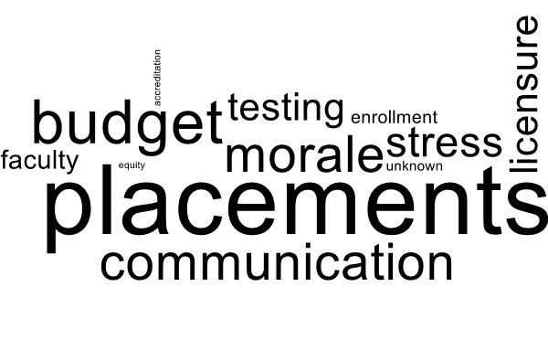

Slide 27
Themes of the open-ended responses
Fear and uncertainty about enrollment and budgets, capacity of PK-12 schools to host field placements, and state licensure requirements
Pride in the ability of faculty, students, and staff to quickly transition to an online environment
Worry about stress, mental health, morale, and communication among faculty, staff, and students
Concern about--and commitment to—supporting under-represented students

Slide 28
Summary

Slide 29
Instruction
Virtually all programs have transitioned to fully online instruction, using synchronous and a synchronous methods.
Faculty have received training in online instruction, and IT support has increased.
Many institutions are providing devices for students as needed.
Field Placements and Licensure
Most states have waived clinical requirements, but almost 40 percent of respondents report that their state has not adjusted its assessment policy.
Access to testing was a challenge named by numerous respondents.
Nearly half of respondents indicated that field placements have been discontinued for at least some of their students; uncertainties regarding field placements for the fall was a significant concern of respondents.

Slide 30
Field Placements and Licensure (continued)
Simulation is not yet a widespread option for students whose placement has been cancelled; it is being used by one-third of respondents.
Three out of four respondents reporting having candidates whose placements have been cancelled and who are available to assist PK-12 schools.
Recruitment and Enrollment
23 percent of respondents expect a decline in continuing student enrollment of more than 10 percent, and 40 percent expect such a decline among new students.
Budget cuts due to both enrollment decreases and state funding cuts are a significant concern among respondents.

